Slide 1
Course Introduction
ITSC205
Operating Systems Internals

Slide 2
Windows Startup

Slide 3
Booting Windows
Devices to boot Windows from:
Fixed disks
Removable media
USB flash devices
Network booting through PXE
iSCSI booting from iSCSI devices
Currently there are three firmware interfaces:
Basic Input Output (BIOS)- The facto standard
Extensible firmware Interface (EFI)
Unified Extensible Firmware Interfaces (UEFI)

Slide 4
Computer Startup
bootstrap program is loaded at power-up or reboot
Initializes all aspects of system
Loads operating system kernel and starts execution
Typically stored in ROM or EPROM, generally known as firmware
e.g smarphones have EEPROM to store their factory-installed programs

Slide 5
Firmware
Firmware is hardware-specific code (software)that provides the first set of instructions that run during the boot process. After the firmware finishes detecting hardware and initializing the system, the firmware interface passes control to the operating system.
Firmware is stored in ROM, EPROM or flash memory

Slide 6
ARM Processor Firmware
The choice of which firmware to use for a particular ARM-based system depends on the specific application, which can range from loading and executing a sophisticated operating system to simply relinquishing control to a small microkernel.
It is common for the same executable to operate on different cores and platforms. The firmware has to identify and discover the exact core and platform it is operating on.
e.g. the core is normally recognized by reading register 0 in coprocessor 15, which holds both the processor type and the manufacturer name.

Slide 7
BIOS
Some of the limitations of BIOS are:
16-bit
Slow performance on ROM startup
The design provide only standard to boot from disks
MBR use 32-bits for storing logical block address(LBA) and stores data in blocks of 512 bytes
Master Boot Record (MBR) maximum bootable disk size of 2.2 TB
MBR allows maximum of 4 primary partitions

Slide 8
Unified Extensible Firmware Interface - UEFI
UEFI is a replacement for the older BIOS firmware interface. It allows to boot from disks that are larger than 2 terabytes.
This interface contains data tables with platform information, boot and run time service calls available to the OS and the bootloader
It supports faster boot and resume times.
UEFI hard disks require the GUID partition table (GPT) partition structure, instead of the master boot record (MBR) partition structure that is used in BIOS.
When you install Windows by using the Windows product DVD, Windows Setup detects whether the computer was booted in UEFI mode or BIOS-compatibility mode, and it configures Windows based on this selection

Slide 9
Legacy Bios and UEFI
The advantages of UEFI over BIOS are the following:
Security features such as Secure Boot and encrypted drives that prevent malware from running before the OS is loaded
Faster startup and resume times
UEFI uses 64-bit values to describe partitions allowing GPT to handle disks of up to 9.4 Zettabytes(ZB)
Support for modern, 64-bit firmware device drivers that the system can use to address more than 17.2 billion GB of memory during startup
Backward compatibility to use BIOS with UEFI hardware, although Secure Boot must be turned off
Support for multicast image deployments
http://uefi.org/
http://www.uefi.org/sites/default/files/resources/UEFI%20Primer_Aug%2015%202014_Final.pdf

Slide 10
Legacy BIOS and UEFI
http://electronicdesign.com/dev-tools/what-s-difference-between-firmware-then-and-now

Slide 11
UEFI Boot and Windows 10
UEFI (Unified Extensible Firmware Interface) is a standard firmware interface for personal computers.
It was designed to replace BIOS (basic input/output system). BIOS has been the PC firmware standard for decades, but with the recent advancements in computer hardware, the stage is being set to remediate its shortcomings with the UEFI standard.
More than 140 technology companies participate in the Unified EFI Forum, including Microsoft. New devices being shipped with Windows 10 must have UEFI firmware by default and Secure Boot technology turned on.
Regardless of this requirement, legacy BIOS systems will still function with Windows 10 installed.

Slide 12
BIOS Boot Process
BIOS
When powered on, the machine will first
POST - testing hardware, memory, etc.
BIOS will search for MBR on any number of devices, according to BIOS setup
MBR will direct the system to the OS
After this, the boot process vary for each operating system

Slide 13
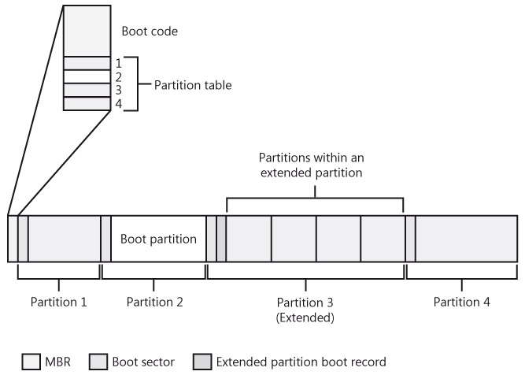
System/boot partitions
Notes:
Permission is granted to copy, distribute and/or modify this document under the terms of the GNU Free Documentation License, Version 1.2 or any later version published by the Free Software Foundation; with no Invariant Sections, no Front-Cover Texts, and no Back-Cover Texts.

Slide 14
MBR and GPT
Windows supports two partition styles MBR and GPT.
The key difference between the GPT partition style and the MBR partition style has to do with how partition data is stored
MBR uses a partition table that describes where the partitions are located on the disk.
The first sector on a hard disk contains the MBR and a master boot code that’s used to boot the system.
The MBR resides outside of partitioned space.
The Master Boot Record contains the disk signature and partition table and is the first sector of the hard drive.
A boot sector contains the BIOS parameter block and marks the first sector of the file system

Slide 15
GPT
Each GPT partition table has a header. The GPT header also defines its location on the disk, its globally unique identifier (GUID), and a 32-bit cyclic redundancy check (CRC32) checksum that is used to verify the integrity of the GPT header.
GPT disks support partitions of up to 9.4 Zettabytes in size and up to 128 partitions per disk.
GPT is recommended for disks larger than 2 TBs on x86 and x64 systems or any disks used on Itanium-based computers.
https://en.wikipedia.org/wiki/GUID_Partition_Table

Slide 16
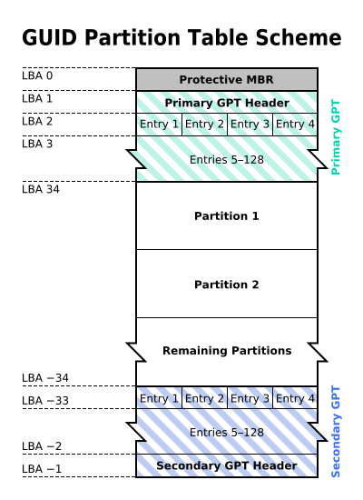
GPT

Slide 17
GPT and virtual machines
For virtual machines and Hyper-V specifically, GPT is only used for data disks and not for boot disks. The reason for this is that Hyper-V emulates a BIOS firmware environment and won’t recognize the Extensible Firmware Interface (EFI)

Slide 18
Windows Boot Process
http://social.technet.microsoft.com/wiki/contents/articles/11341.the-windows-7-boot-process-sbsl.aspx

Slide 19
Windows Boot Process
POST ( Power on self test )
Starts with an electrical signal that clears the leftover data from the chip’s internal registers and resets the Program Counter to a specific number F000 (address of the ROM BIOS boot program)
Checks :
Chips,ports, slots
Video controller card
RAM
Keyboard
Secondary storage
BIOS reads MBR and Loads Boot Record
Finds Bootmgr , which displays boot loader
Bootmgr reads BCD- Boot Configuration Data
System loads NTOSKRNL.EXE
Notes:
MBR Contains small amount of code that scans partition table of 4 entries.
First partition marked active is selected as the system volume
Loads boot sector of system volume Boot sector (NT-specific code).Reads root directory of volume and loads NTLDR
NTLDR
Moves system from 16-bit to 32-bit mode and enables paging
Reads and uses Ntbootdd.sys to perform disk I/O if the boot volume is on a SCSI disk different than the system volume
This is a copy of the SCSI miniport driver used when the OS is booted
Reads Boot.ini
Boot.ini selections point to boot drive
Specifies OS boot selections and optional switches (most for debugging/troubleshooting) that passed to kernel during boot
If more than one selection, NTLDR displays boot menu (with timeout)
If you select a 64-bit installation, NTLDR moves the CPU into 64-bit mode

Slide 20
Windows Boot Process
Ntoskrnl.exe Creates the Session Manager process (\Windows\System32\Smss.exe), the first user-mode process
Smss.exe:
Runs programs specified in BootExecute e.g. autochk, the native API version of chkdsk
Initializes the paging files and rest of Registry (hives or files)
Loads and initializes kernel-mode part of Win32 subsystem (Win32k.sys)
Starts Csrss.exe (user-mode part of Win32 subsystem)
Starts Winlogon.exe
Winlogon.exe:
Starts Lsass.exe (Local Security Authority)
Loads GINA DLL (Graphical Identification and Authentication)
Displays logon dialog
Starts Services.exe (the service controller)
Services.exe starts Win32 services marked as “automatic” start
Also includes any drivers marked Automatic start
Service startup continues asynchronous to logons

Slide 21
NTOSKRNL
Core operating system image
contains Executive & Kernel
Also includes entry points for routines actually implemented in Hal.Dll
Many functions are exposed to user mode via NtDll.Dll and the environment subsystems.
Four retail variations:
NTOSKRNL.EXE Uniprocessor
NTKRNLMP.EXE Multiprocessor
Two checked build (debug) variations:
NTOSKRNL.EXE,
NTKRNLMP.EXE Debug multiprocessor
NTKRNLPA.EXE,
NTKRPAMP.EXE Debug multiprocessor w/extended addressing

Slide 22
BIOS Boot Process Components
Component | Processor Execution | Responsibilities
Master Boot Record (MBR) | 16-bit real mode | Reads and loads partition boot sectors
Boot sector | 16-bit real mode | Reads the root directory to load Bootmgr.
Bootmgr | 16-bit real mode and 32-bit without paging | Reads the Boot Configuration Database (BCD), presents boot menu, and allows execution of preboot programs such as the Memory Test application (Memtest.exe). If a 64-bit installation is booted, switches to 64-bit long mode before loading Winload.

Slide 23
BIOS Boot Process Components
Winresume.exe | 32-bit protected mode, 64-bit protected mode if resuming a Win64 installation | If resuming after a hibernation state, resumes from the hibernation file (Hiberfil.sys) instead of typical Windows loading.
Memtest.exe | 32-bit protected mode | If selected from the Boot Manager, starts up and provides a graphical interface for scanning memory and detecting damaged RAM.
Ntoskrnl.exe | Protected mode with paging | Initializes executive sub-systems and boot and system-start device drivers, prepares the system for running native applications, and runs Smss.exe.

Slide 24
BIOS Boot Process Components
Hal.dll | Protected mode with paging | Kernel-mode DLL that interfaces Ntoskrnl and drivers to the hardware.
Smss.exe | Native application | Initial instance starts a copy of itself to initialize each session. The session 0 instance loads the Windows subsystem driver (Win32k.sys) and starts the Windows subsystem process (Csrss.exe) and Windows initialization process (Wininit.exe). All other per-session instances start a Csrss and Winlogon process.
Wininit.exe | Windows application | Starts the service control manager (SCM), the Local Security Authority process (LSASS), and the local session manager (LSM). Initializes the rest of the registry and performs user-mode initialization tasks.

Slide 25
BIOS Boot Process Components
Winlogon.exe | Windows application | Coordinates logon and user security, launches LogonUI.
Logonui.exe | Windows application | Presents interactive logon dialog box.
Services.exe | Windows application | Loads and initializes auto-start device drivers and Windows services.

Slide 26
Windows Services
What is the purpose of svchost.exe process ?
Is a process that runs services from Dynamic-Link Libraries(DLLs). Each instance of svchost runs one or more services
To display Windows services use one of the following tools:
1.Search -- > Services
2.System Information → Software Environment → Services
3.cmd → tasklist /svc

Slide 27
BCD – Boot Configuration Data
The Windows bootloader is the operating system component that manages the boot process.
The ability to configure the boot process is valuable, especially if the boot has been corrupted by a virus or malfunctioning software.
In Windows 7, the boot.ini file has been replaced with Boot Configuration Data (BCD).

Slide 28
Windows Boot Loader
Microsoft Windows bcdedit is a tool used to manage the boot loader entries.
BCDEDIT needs a boot loader file to boot your system.
A boot loader is a file that contains necessary information that instructs the system how to boot/start an operating system.
Windows 10 boot loader file is “bootmgr” located under primary partition C:\Windows\Boot\Pcat.

Slide 29
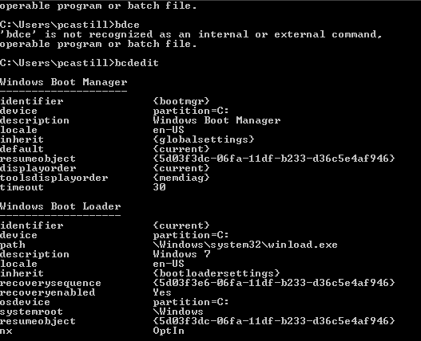
bcdedit
Notes:
“Microsoft product screen shot(s) reprinted with permission from Microsoft Corporation.”

Slide 30
bcedit commands
bcdedit /set {current} description "My edited Windows Boot Entry" This changes the title of the boot menu entry "{current}".
bcdedit /set {ntldr} path \ntldr Tells bcd that the ntldr file is on root folder "\" (of drive e: as stated above)
bcdedit /displayorder {ntldr} /addfirst This places Windows as the first OS on the menu list.
bcdedit /default {ntldr} This places Windows as the default OS to boot first with.

Slide 31
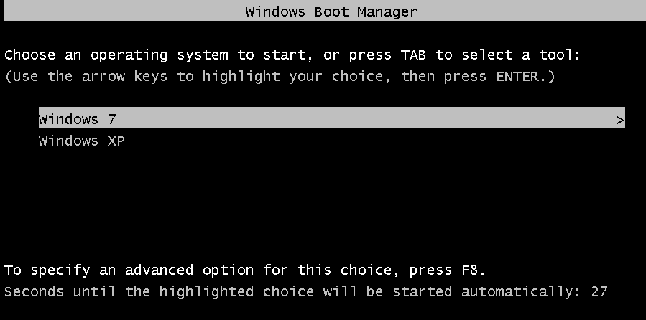
Windows Boot Loader
Notes:
“Microsoft product screen shot(s) reprinted with permission from Microsoft Corporation.”

Slide 32
Bootmgr and BCD
Bootmgr reads the BCD file from the \Boot directory using built-in file system code.Bootmgr contains read-only NTFS code
Bootmgr next clears the screen.
If there is more than one boot-selection entry in the BCD, Bootmgr presents the user with the boot-selection menu

Slide 33
Bootmgr and BCD
if there is only one entry, Bootmgr bypasses the menu and proceeds to launch Winload.exe
Entries in the BCD can include optional arguments that Bootmgr, Winload, and other components involved in the boot process interpret.

Slide 34
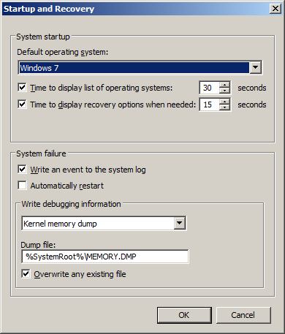
Windows System Startup
Notes:
“Microsoft product screen shot(s) reprinted with permission from Microsoft Corporation.”

Slide 35
Boot Options
Advanced menu option introduced in Windows 2000
Press F8 at startup to choose more options than just a regular boot

Slide 36
Advanced Options Menu
Safe Mode
Safe Mode with Networking
Safe Mode with Command Prompt
Enable Boot Logging
Enable VGA mode
Last Known Good Configuration
Directory Services Restore Mode (Windows 2000 Domain Controllers Only)
Debugging Mode
Boot Normally
Notes:
“Microsoft product screen shot(s) reprinted with permission from Microsoft Corporation.”

Slide 37
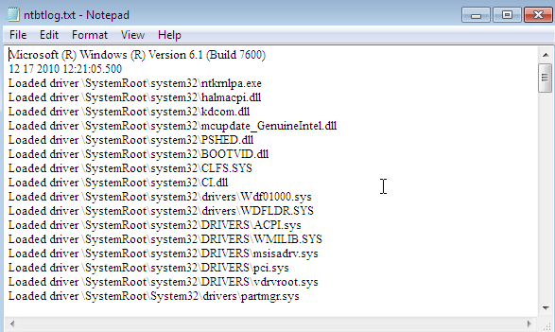
Ntbtlog.txt
Notes:
“Microsoft product screen shot(s) reprinted with permission from Microsoft Corporation.”

Slide 38
Wow64
64 bit Windows operating systems run 32 bit applications by using an x86 emulator called Windows on Windows 64 or WOW64.
Wow64 intercepts system calls from the 32-bit application
Converts 32-bit data structure into 64-bit aligned structures
Issues the native 64-bit system call
On x64, instructions executed by hardware
On IA64, instructions have to be emulated

Slide 39
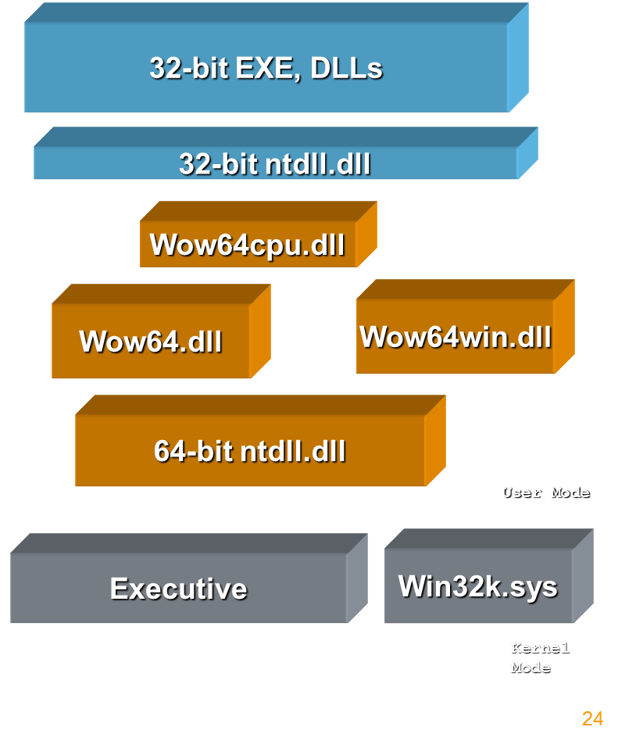
Wow64 Components

Slide 40
Wow64 File Location
Location of system files
64-bit system files are in \windows\system32
32-bit system files are in \windows\syswow64
32-bit applications live in “\Program Files (x86)”
64-bit applications live in “\Program Files”
File access to %windir%\system32 redirected to %windir%\syswow64

Slide 41
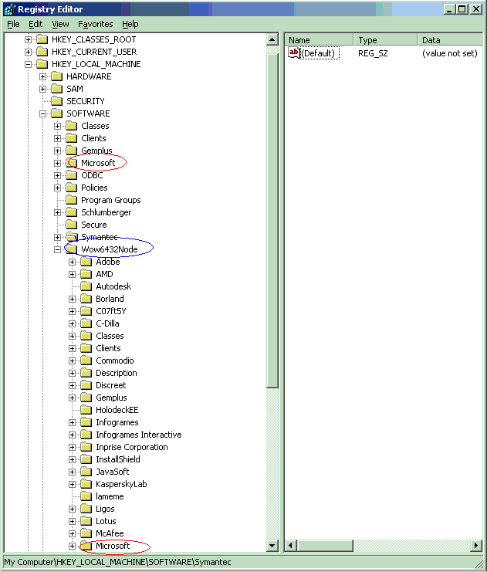
Wow64 Registry Redirection
Two registry keys have 32-bit sections:
HKEY_LOCAL_MACHINE\Software
HKEY_CLASSES_ROOT
Everything else is shared
32-bit data lives under \Wow6432Node
When a Wow64 process opens/creates a key, it is redirected to be under Wow6432Node

Slide 42
Shutdown Process
What happens when Windows performs a normal shutdown?
ExitWindowsEx function sent to Csrss
Start menu->shutdown: Explorer calls it
CTRL+ALT+DEL->shutdown: Winlogon calls it
If not a forced shutdown, Csrss sends query message to all threads owning top-level windows
Processes can cancel shutdown if not a “forced” shutdown
Interactive shutdowns are not forced
If all answer ok, Csrss sends shutdown message
Csrss waits for time defined by HKCU\Control Panel\Desktop\HungAppTimeout
If timeout expires, shows Window to close applications
Csrss tells Service Control Manager (Services.exe) to exit, which tells all Win32 services to exit

Slide 43
Troubleshooting the Boot
MBR Corruption
Boot Sector Corruption
BCD Misconfiguration
System File Corruption

Slide 44
Secure or trusted boot
Secure Boot is a security standard developed by members of the PC industry to help make sure that your PC boots using only firmware that is trusted by the PC manufacturer.
When the PC starts, the firmware checks the signature of each piece of boot software, including firmware drivers (Option ROMs) and the operating system. If the signatures are good, the PC boots, and the firmware gives control to the operating system.
The following versions of Windows support Secure Boot: Windows 8.1, Windows Server 2012 R2, Windows RT 8.1, Windows 10, Windows Server 2012, and Windows RT.
http://technet.microsoft.com/en-us/windows/jj737995.aspx

Slide 45
References
Mark E. Russinovich and David A. Solomon, “Windows Internals”, Latest Edition, Microsoft Press.
Startup and Shutdown
Boot process
Troubleshooting Boot and Startup Problems
Shutdown

